Slide 1
Minesweeper
Kelly Feldman, Jahow Yu, Damien Chen

Slide 2
Game Description
Objective:
Clear all non-mine cells on a board while avoiding cells with mines
Non-mine cells will display how many tiles away it is from a mine (within 4 adjacent units)
Win:
Avoid all mines
Lose:
Click on one mine, lose automatically

Slide 3
To-Do
Implement levels (increased number of mines)
Win/Lose display
Sound effect when clicking mine

Slide 4
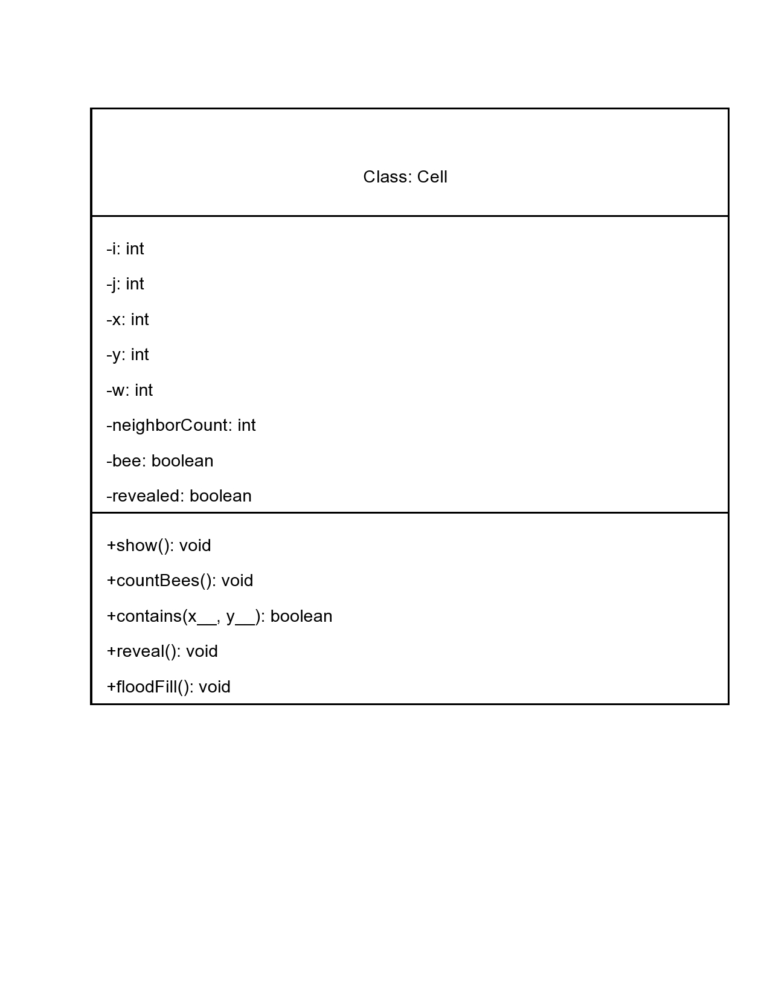
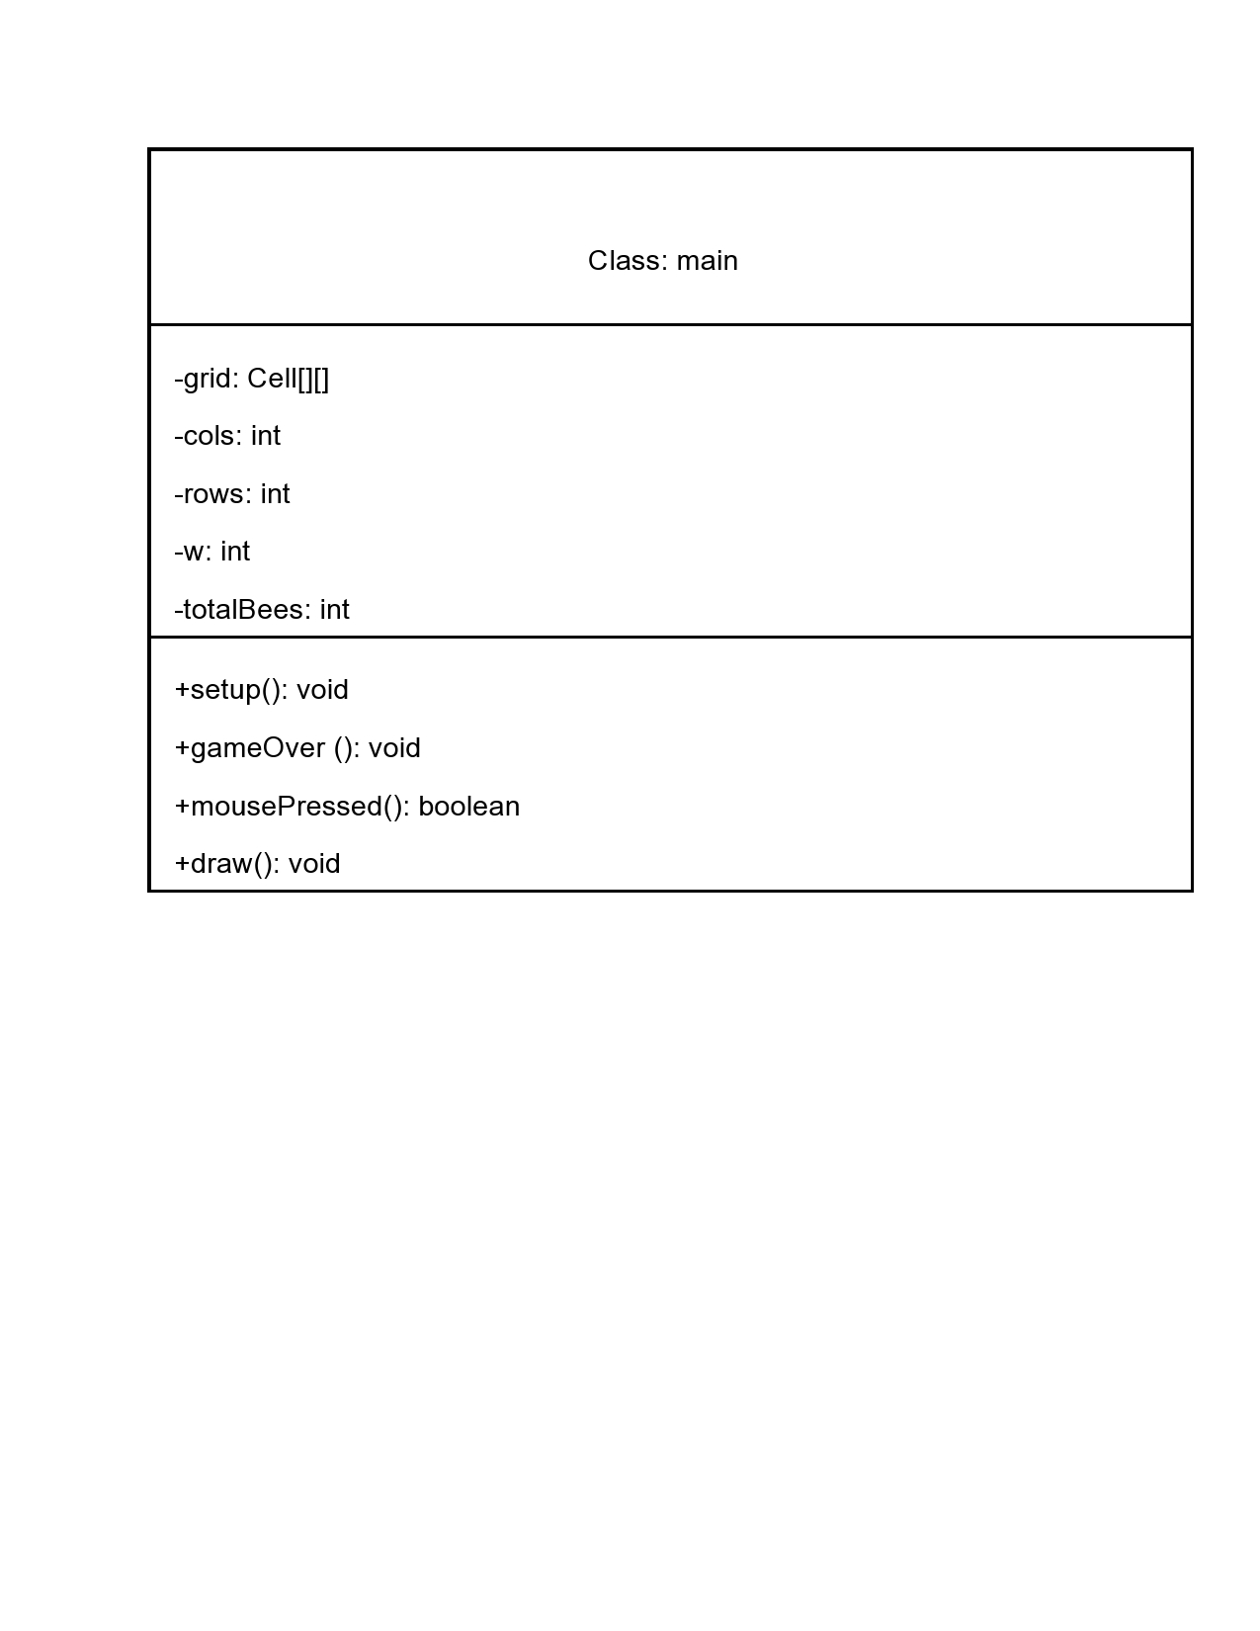
UML

Slide 5
Individual Responsibility
Jahow:
Print board based on difficulty selection
Randomly generate mine location/frequency
Kelly:
Print cells within distance from mine
Track player win/lose
Damien:
Uncover cells based on player input
Initiate game
Open game window

Slide 6

Demo - Winning Scenario

Slide 7
Demo - Losing Scenario

Slide 8
Thank you! Questions?

